Slide 1
Team B Group 2​ Final Results​
Gene Prediction & Functional Annotation Pipeline
Group members: Zahra, Aditi, Fanshi

Slide 2
Agenda
Project context & role in pipeline
Dataset received from Group 1
Annotation pipeline design
Final results

Slide 3
Dataset overview
We received 34 assembled bacterial genome from Group 1. This serves as the input to our prediction annotation workflow.
Total Genomes Received | 34 Draft Bacterial Assemblies
Source | Sequenced and assembled by Group 1
Average Genome Size | ~2.07 Mb
Assembly Complexity | High fragmentation across all samples
Average Contigs | ~197
Average N50 | ~17.6 kb
Format | Multi-FASTA files (.fasta)

Slide 4
Pipeline + tools
Phase 2
Genome Assembly (.fasta)
Phase 1
CDS Prediction
Prodigal and GLIMMER
rRNA detection/ Structural annotation
RNAmmer and Barrnap
Protein FASTA (.faa)
Extract 16S rRNA
Phase 3
Functional Annotation
eggnog-mapper
BLASTn (core_nt) → Species Identification

Slide 5
Why rRNA Detection?
rRNA genes are essential bacterial markers
16S rRNA is used for species identification
We compare two structural annotation tools
Goal: balance accuracy vs computational cost

Slide 6
Tools: RNAmmer vs Barrnap
By comparing Barrnap vs RNAmmer we want to determine whether RNAmmer’s computational overhead is justified for draft genomes, or if Barrnap’s speed makes it the better choice for our final pipeline
Feature | RNAmmer | Barrnap
HMM Engine | HMMER2 (legacy) | HMMER3 (modern)
Installation | Manual | Conda
Speed | Slow | Fast
Status | Older | Actively maintained

Slide 7
rRNA Detection
We applied both Barrnap and RNAmmer on ~34 genome sequences to compare performance and accuracy for rRNA detection
Both tools detected identical rRNA genes (16S, 23S, 5S) across all genomes
Feature | RNAmmer | Barrnap
Genomes analyzed | ~34 | ~34
16S | 34/34 | 34/34
23S | 34/34 | 34/34
5S | 34/34 | 34/34
Total rRNA/genome | 3 | 3
Total runtime | ~20 min | ~1-2 min
Avg runtime/genome | ~37 s | ~0.9 s

Slide 8
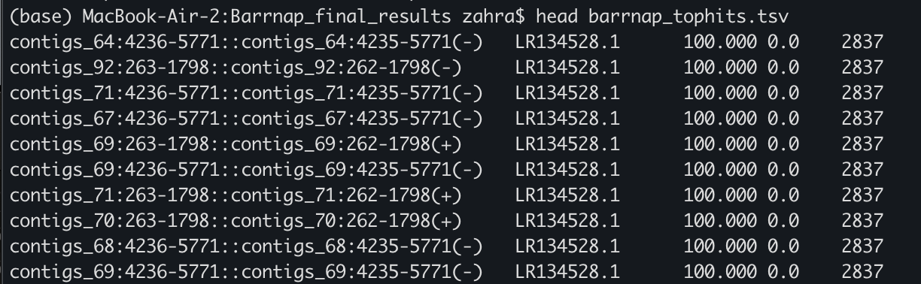
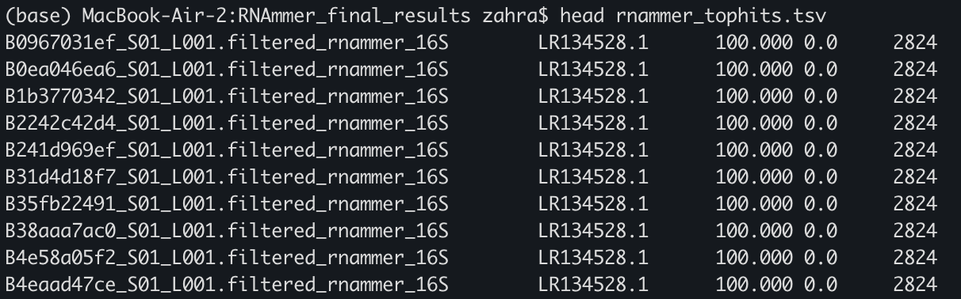
BLASTn : Species Identification (Using 16S rRNA)
We used BLASTn on the extracted 16S sequences from both Barrnap and RNAmmer.
Both tools produced identical top hits across all genomes, specifically accession LR134528.1, with 100% identity and coverage.
This confirms that both tools consistently identify the same species.
But there is some differences in contig numbers in Barrnap and RNAmmer
Barrnap
RNAmmer

Slide 9
Final Evaluation
Phase 1 Conclusion
Structural output: Equivalent
Species identification: Identical
Computational cost: Barrnap significantly faster
Selected tool for final pipeline: Barrnap and RNAmmer

Slide 10
Coding Sequence (CDS) Prediction
Identify protein-coding genes
Generate protein FASTA (.faa)
Input for functional annotation
Compare three gene prediction tools
Implement two of them for final results

Slide 11
Tool Architecture
Tool | Model Type | Strength
Prodigal | Self-training heuristic | Fast, optimized for bacteria
GLIMMER | Interpolated Markov model | Classical gene finder
GeneMarkS-2 | Self-training HMM | High accuracy

Slide 12
Tool Architecture
GLIMMER (IMM): High sensitivity; may overpredict short or overlapping ORFs.
GeneMarkS-2 (HMM): Self-training (–ES mode); adapts to genome GC content.
Prodigal (Dynamic Programming): Conservative gene boundaries; directly outputs translated proteins (.faa).
Metric | Prodigal (v2.6.3) | GLIMMER (v3.02) | GeneMarkS-2 (v1.15_1.25_lic)
Bea3b88bb9 | 1,966 | 2,209 | 2,170
Bfe6f82f31 | 1,982 | 2,209 | 2,174
Bea Execution Time | 0m4.078s | 0m5.133s | 0m11s
Bfe Execution Time | 0m2.494s | 0m3.563s | 0m12s
Output Files Generated | .gff, .faa, .log | .predict, .icm, .log | .gff, .faa, .fnn
Primary Algorithm | Dynamic Programming | Interpolated Markov Models | Hidden Markov Models

Slide 13
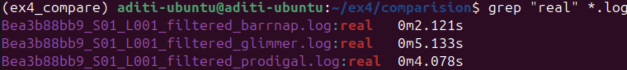
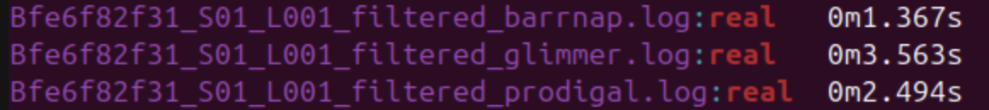
Runtime Comparison
Prodigal demonstrated consistently fast runtime than Glimmer across all 34 genomes.
Genome | Prodigal (s) | Glimmer (s) | GeneMarkS-2
Bea3b88bb9 | 4.08 | 5.13 | 11
Bfe6f82f31 | 2.49 | 3.56 | 12
Average | 3.29 | 4.35 | 11.5
Scalability
Prodigal and GLIMMER were successfully scaled to all 34 genomes natively on Ubuntu, completing the batch in under 5 minutes.
GeneMarkS-2: reliance on Docker and Rosetta added unnecessary infrastructure overhead

Slide 14
CDS Count
Tool | Genomes Analyzed | Avg. Total CDS | Avg Length (bp)
Prodigal | 34 | ~1757 | ~874
GLIMMER | 34 | ~2019 | ~897
GeneMarkS-2 | 2 (Benchmark) | ~2172 | ~810
GLIMMER Over-prediction: Across all 34 genomes, GLIMMER predicted ~15% more genes than Prodigal. This suggests the Interpolated Markov Model (IMM) is highly sensitive but prone to over-predicting short ORFs in fragmented assemblies.
Prodigal Conservatism: Prodigal maintained a more realistic bacterial coding density. Its dynamic programming approach is better suited for the 197+ contigs in our dataset, where genes are frequently truncated at contig edges.
Notes:
Observations
GLIMMER predicted the highest number of genes (2209 CDS) and slightly longer average gene lengths, suggesting possible overprediction of overlapping ORFs.
GeneMarkS-2 produced an intermediate gene count (~2170 CDS) with slightly shorter average lengths, indicating a more balanced prediction compared to GLIMMER.
Prodigal predicted the lowest number of genes (~1966–1982 CDS) with consistent average lengths (~874 bp), suggesting a more conservative gene-calling approach.

Slide 15
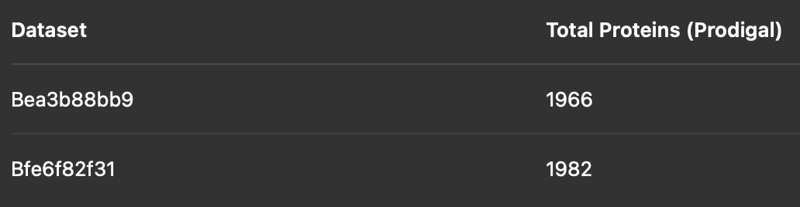
Functional Annotation
Input:
Prodigal predicted proteins (.faa)
Tools used:
InterProScan (domain-based) → What biological process is this protein involved in?”
eggNOG-mapper (orthology-based) → Which structural domains enable this function
eggNOG-mapper scaled to all 32 genomes in production run

Slide 16
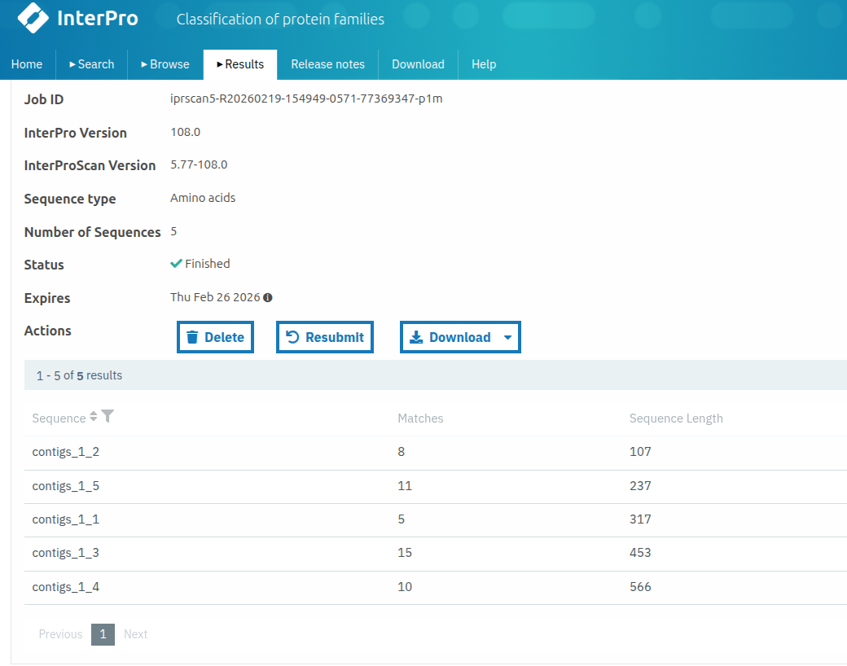
InterPro Results Summary
InterPro
Total proteins analyzed: 5
Total domain/motif hits detected: 49
Proteins with ≥1 annotation: 5 / 5 (100% coverage in subset)
Average hits per protein: 9.8
InterProScan provides sub-gene level structural annotation
Multiple domain predictions per protein
High structural resolution
Subset demonstrates strong domain detection capability

Slide 17
EggNOG Functional Annotation Results
Metric | Avg (n=32) | Min | Max
Prodigal CDS input | 1,759 | 1,696 | 1,795
eggNOG ortholog assignments | 1,692 (96.2%) | 1,632 | 1,722
With COG category | 1,585 (93.7%) | 1,531 | 1,610
With KEGG KO | 1,299 (76.7%) | 1,253 | 1,311
With GO terms | 818 (48.3%) | 769 | 830
With PFAM domains | 1,563 (92.4%) | 1,510 | 1,587
With EC number | 676 (39.9%) | ~650 | ~700
Consistent annotation rates across all 32 bacterial genomes (s.d. < 1% for all metrics)

Slide 18
COG Functional Category Distribution
Category | Description | Count (32 genomes) | % of Annotated
S | Function unknown | 10,213 | 18.9%
L | Replication, recombination, repair | 4,588 | 8.5%
J | Translation, ribosomal structure | 4,429 | 8.2%
M | Cell wall/membrane biogenesis | 4,252 | 7.9%
C | Energy production and conversion | 4,159 | 7.7%
H | Coenzyme transport and metabolism | 3,319 | 6.1%
E | Amino acid transport and metabolism | 3,111 | 5.7%
P | Inorganic ion transport | 2,736 | 5.1%
K | Transcription | 2,434 | 4.5%
F | Nucleotide transport and metabolism | 1,419 | 2.6%
• ~19% unknown function (COG S) is typical for bacterial genomes
• Strong housekeeping categories (J, L, M, C) consistent with N. meningitidis
• Metabolic categories (E, H, P) reflect the organism's nutritional requirements

Slide 19
Functional Annotation Strategy Comparison
Feature | eggNOG-mapper | InterProScan
Input size | Full proteome (~1,759 avg CDS per genome) | Representative subset (5 proteins)
Annotation scale | Genome-wide | Per-protein structural analysis
Coverage (this study) | 96.2% proteome annotated | 100% within subset
Main output type | Ortholog groups, COG, KEGG, EC | Domains, motifs, structural signatures
Biological resolution | Functional pathway level | Domain / structural level
Primary strength | Metabolic context | Architectural precision
Role in pipeline | Global functional assignment | Structural validation & refinement
The high eggNOG annotation rate and InterPro domain richness confirm that our CDS predictions are biologically consistent and suitable for downstream functional and comparative analyses.

Slide 20
Thanks for your attention

